Slide 1


Slide 2

Introduction
Bright Coffee Shop collects sales data from its daily transactions. This data helps the business understand customer purchasing pattern, product performance and revenue.
1

Slide 3
Business Problem
Bright Coffee Shop wants to increase revenue and improve product performance. This analysis uses sales data to
identify patterns and opportunities for growth.
01
02
03
Increase revenue 💸
Improve products ☕
Understand sales 📊
Identify where revenue is strongest.
Understand high- and low-performing products.
Identify useful sales patterns.
2

Slide 4
Data & Methodology
Excel Dataset
Databricks
SQL
Power BI/Excel
Recommendations
→
→
→
→
Daily transactional coffee sales
Load, inspect and store data
Clean, transform and calculate
Analyze and visualize
Turn findings into actions
4

Slide 5
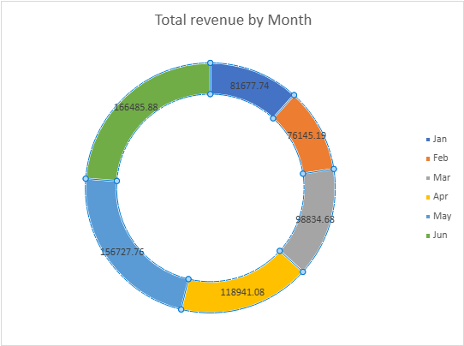
Overall Sales Performance
TOTAL REVENUE
TOTAL UNITS SOLD
TOTAL SALES
NUMBER OF STORES
TOTAL SALES
R698 812.33
214 470
149 116
3
SUPPORTING VISUAL
DATE
01 Jan 2023 – 30 Jun 2023
Bright Coffee made R 698,812 in revenue from 149,116 sales and 214,470 units across the three stores in the first half of 2023, with revenue rising from R81 677 in January to R166 485 in June
KEY MESSAGE

Slide 6
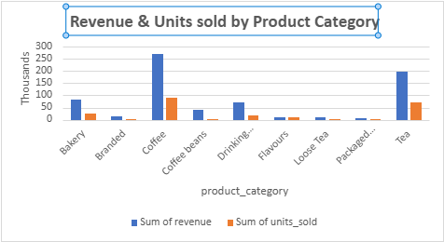
Product Performance
TOP SALES & REVENUE PRODUCT
COFFEE
Coffee is the engine of the business with R269 952 in revenue from 89,250 units sold across January to June 2023.
.

Slide 7
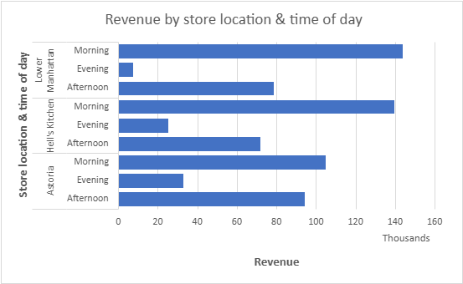
Revenue by Time
PEAK SALES TIME
Morning
Mornings carry over half the business, so the strongest team should be on the opening shift, not spread evenly across the day.
Coffee, Tea & Bakery items that peak in the morning should be stocked, baked & counted to morning demand.

Slide 8
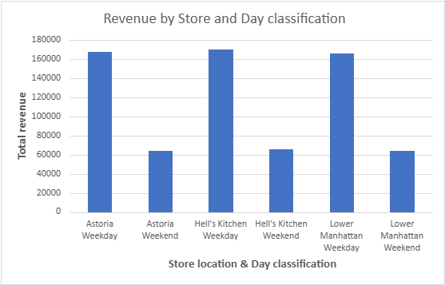
Store Performance
08
STORE INSIGHTS
STORE REVENUE VISUAL
BEST-PERFORMING STORE
Hell’s Kitchen
STORE INSIGHT
Hell’s Kitchen is the best performing store in Revenue, followed by Astoria then Lower Manhattan based on weekdays & weekends.
BRIGHT COFFEE SHOP • SALES ANALYSIS
8

Slide 9
Key Findings
PRODUCT
TIME
Coffee R269 952
Mornings – Peak Sales
STORE
SALES VOLUME PRODUCT CATEGORY TOP 3
Coffee 89 250
Tea 69 737
Bakery 23 214
Hell’s Kitchen R236 511,17
LOW PERFORMING PRODUCTS
Packaged chocolate 487
Branded 776
Loose Tea 1210

Slide 10
Business Recommendations
Focus on high-performing products
Optimize peak sales periods
Protect top sellers. Monitor coffee and tea stock daily, especially before the morning rush, to reduce missed sales caused by stock shortages.
Schedule more staff during the morning peak and assign clear roles for taking
orders, preparing drinks and serving customers.
Test a breakfast bundle, such as coffee and a bakery item, during morning hours
Consider a loyalty reward for repeat morning purchases.
Investigate low performers
Learn from strong stores
Review weaker products like Loose Tea and Branded. Check their revenue,
profit margins,
stock costs and sales trends before deciding whether to promote,
adjust or discontinue them.
Investigate good practices at the best performing location.
Compare stores fairly by considering operating hours and customer traffic.
Lower revenue alone does not necessarily mean that a store is performing poorly.

Slide 11
Conclusion
Bright Coffee has a clear opportunity to increase revenue by strengthening its best performing product categories, capitalising on peak morning demand, and improving the performance of lower-selling products. The analysis identifies coffee as the leading product category, followed by tea and bakery products, with mornings representing the strongest sales period across all three stores.
To support sustainable revenue growth, management should prioritise product availability and efficient staff during peak hours, introduce targeted promotions and product bundles, and use store-level sales data to guide operational decisions. Regular monitoring of revenue, sales volume and profitability will help the business evaluate these initiatives and make data-driven decisions that improve overall performance.

Slide 12
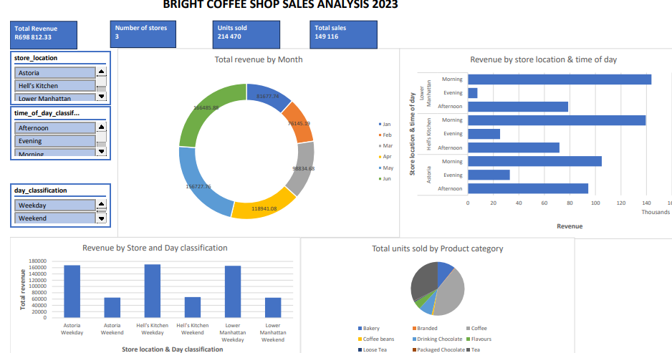
Dashboard
https://excel.cloud.microsoft/open/onedrive/?docId=EE22442B59469123%21sb8f98056028248a1b252da2bd8d62a35&driveId=EE22442B59469123

Slide 13


